Slide 1
Incorporating knowledge in Question Answering
Pulkit Katdare
Supervisors: Feiyang Niu, Feng Gao, Govind Thattai
Final Intern Presentation
Amazon Inc.

Slide 2
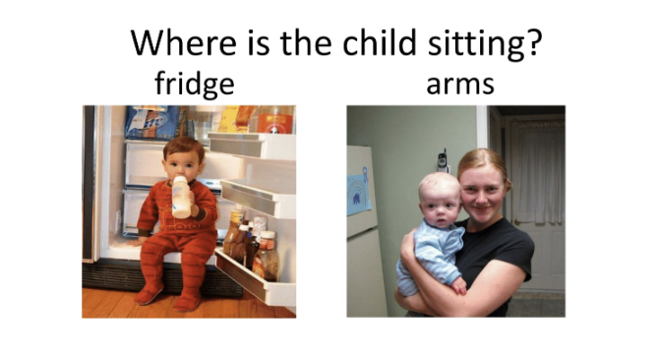
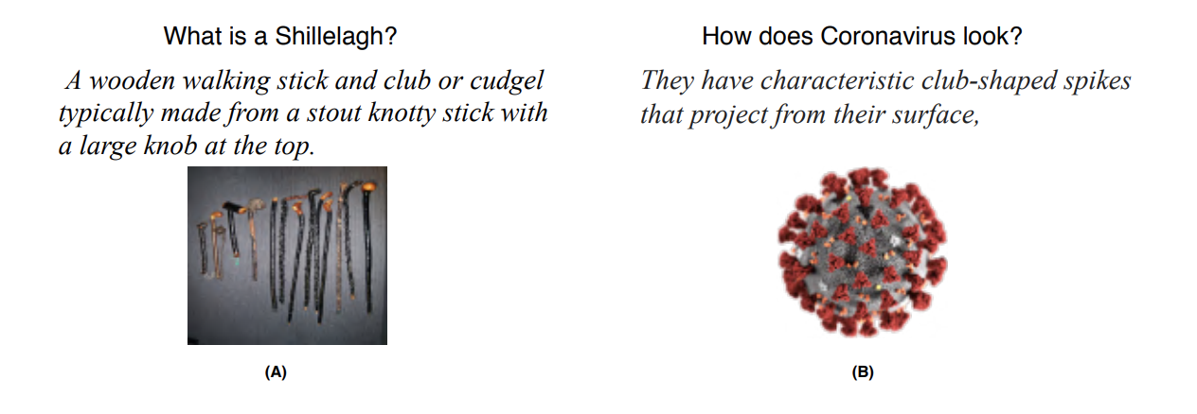
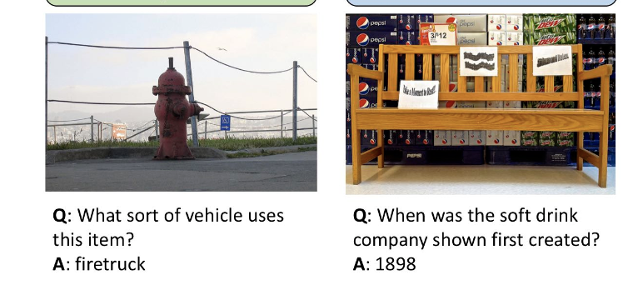
Motivation
Datasets generally address common sensical tasks
Need for open-domain Q&A
Need to correlate information from multiple sources and generate free-form answer

Slide 3
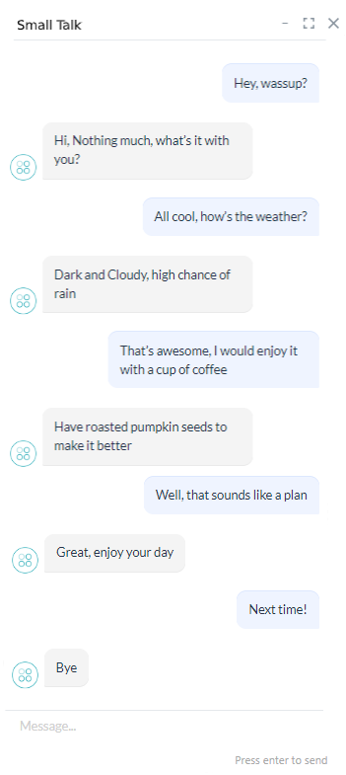
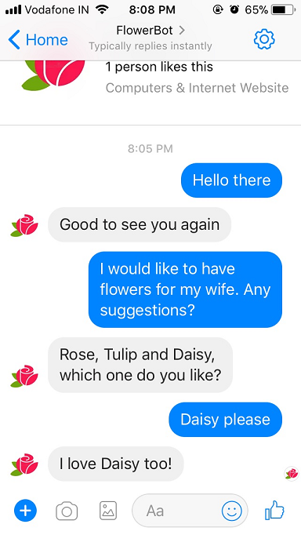
Motivation
Hi, Did golden state win the finals last night?
Yeah, golden state warriors won their 4th NBA championship title this year
Sweet! Did curry win the MVP title?
Yeah he did! Did you that this is Stephen Curry’s First Finals MVP title?
Casual Chatbot
Contexual Chatbot
Knowledge Chatbot

Slide 4
How will a knowledge based Chat bot work?
User asks a question
Search for sources relevant to question
Find relevant sources
Use source plus the question to generate response
Hi, Did golden state win the finals last night?
Yeah, golden state warriors won their 4th NBA championship title this year with 4-2 final score
Sweet! Did curry win the MVP title?
Yeah he did! Did you that this is Stephen Curry’s First Finals MVP title?

Slide 5
WebQA Dataset
Question
Maps the flow of how humans reason rationally
Given the question, we retrieve the relevant knowledge sources
Question combined with the relevant source, generates a free-form answer
Source₁
Source₂
Source₃
Answer

Slide 6
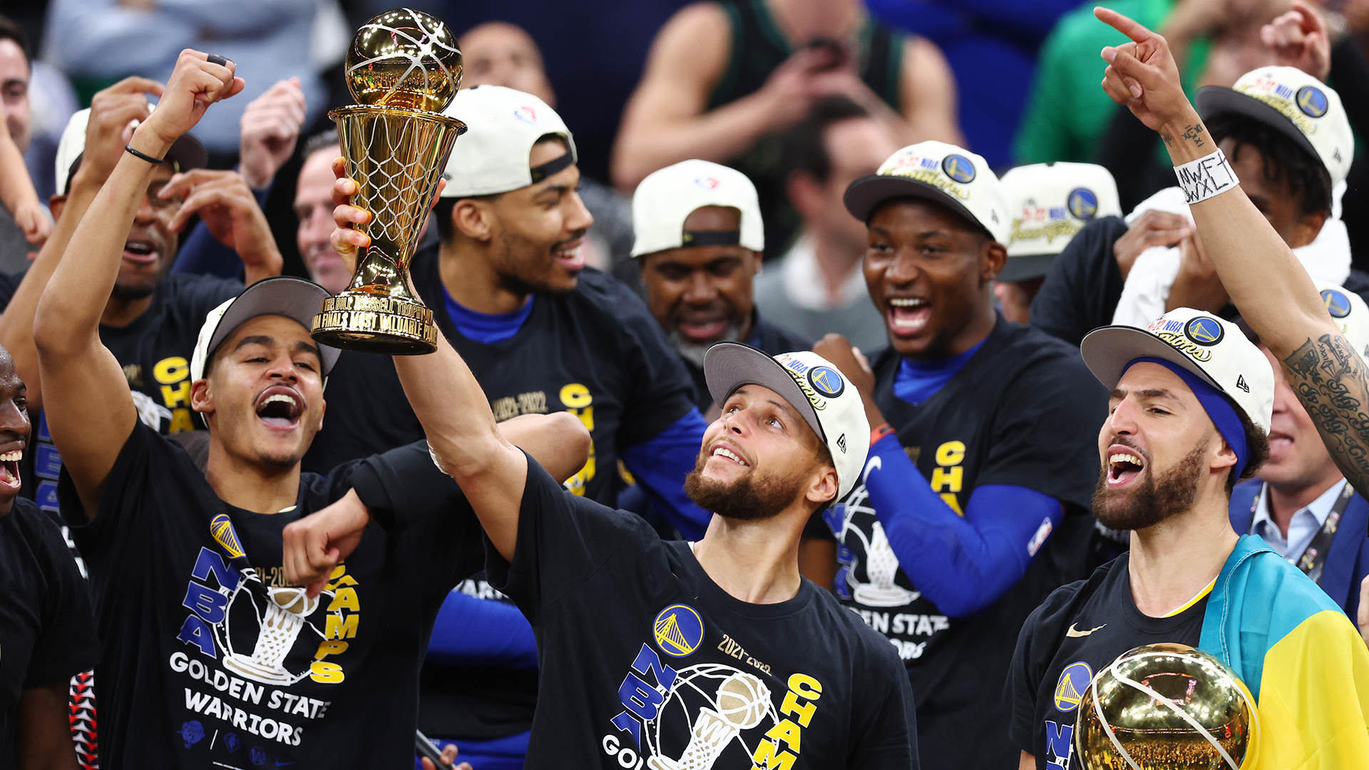
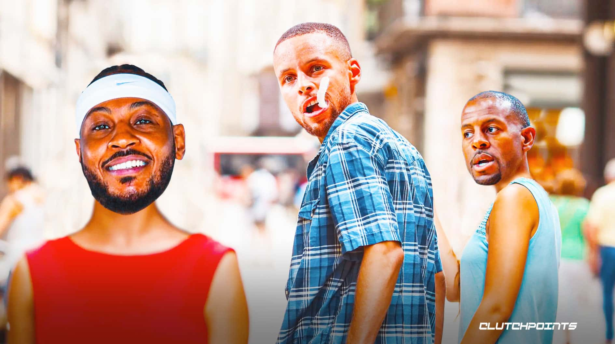
Example
Q: What color is the belly of a Green Tree Frog?
Hi, Did golden state win the finals last night?
S₁: {Caption: Green Tree Frog on verandah tiles 2 Taken in ' 'Chinchilla at a staff house I was staying at, url: Photo of Green Tree Frog}
S₂: {Caption: Litoria caerulea - Darwin NT Litoria caerulea, ' 'Green Tree Frog, female. Darwin, Northern ' 'Territory., url: Belly of Green Tree Frog}
S₃: {In Australia, the frog is also known more simply ' 'as the "green tree frog", but that name is often}
S₄:{Their color varies from bright green to greenish gray or yellow green on back, with white or cream-colored stomach}
Source-1
The Golden State Warriors have climbed the mountain once again, securing this year's NBA championship after beating the Boston Celtics 103-90 in Game 6 to win the series 4-2
Shaq: Steph Curry Is ‘Best Player in the World,’ Warriors Will Win West
Source-n
Yeah, golden state warriors won their 4th NBA championship title this year with 4-2 final score
A: The belly of a Green Tree Frog is white
Relevant
Not-Relevant
*Sources could either be text or (images + text)

Slide 7
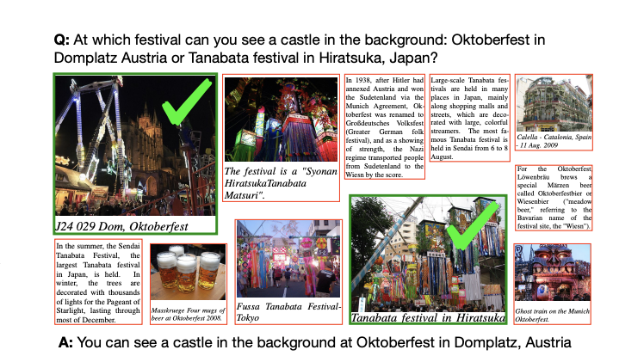
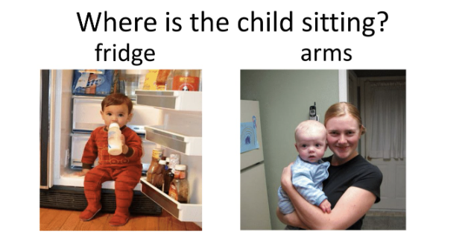
WEBQA
VQA
Webqa has multiple sources to choose answer from
Generative Answer
No distractions
Hard to answer even by human
Single Image and Question
One phrase answer
Distraction is very hard to distinguish
Easily answered by human beings
Notes:
Need to add visualization here

Slide 8
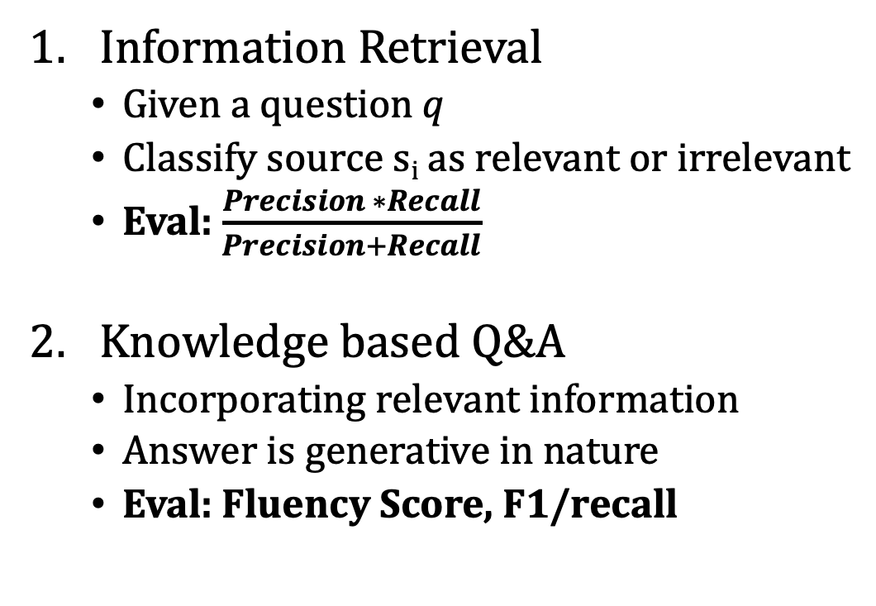
WebQA Dataset Problem
Q: What color is the belly of a Green Tree Frog?
Information Retrieval
Given a question q
Classify source s_{i} as relevant or irrelevant
Eval: $\frac{Precision ∗Recall}{Precision+Recall}$
Knowledge based Q&A
Incorporating relevant information
Answer is generative in nature
Eval: Fluency Score, F1/recall
S₁: {Caption: Green Tree Frog on verandah tiles 2 Taken in ' 'Chinchilla at a staff house I was staying at, url: Photo of Green Tree Frog}
S₂: {Caption: Litoria caerulea - Darwin NT Litoria caerulea, ' 'Green Tree Frog, female. Darwin, Northern ' 'Territory., url: Belly of Green Tree Frog}
S₃: {In Australia, the frog is also known more simply ' 'as the "green tree frog", but that name is often}
S₄:{Their color varies from bright green to greenish gray or yellow green on back, with white or cream-colored stomach}
A: The belly of a Green Tree Frog is white
Relevant
Not-Relevant

Slide 9
Baseline Model
Information Retrieval
Question Answering
S_{i}
Q + A
[Source-1,Source-2, Source-3, ….]
Q + A
Self-Attention Block
Self-Attention Block
Prediction over next 50 words
relevant
Irrelevant

Slide 10
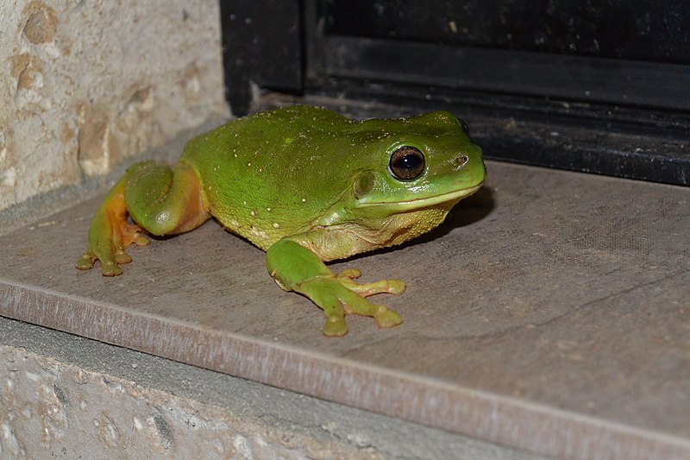
Green Tree Frog on verandah tiles 2 Taken in 'Chinchilla at a staff house I was staying at.
What color is the belly of a Green Tree Frog
‘[SEP]’
Feature extraction
Feature Vector
Word Embedding
Bounding Box
Position Embedding
Token-type embedding

Slide 11
Baseline Model
Information Retrieval
Q&A
Sum of Embeddings
Sum of Embeddings
Self-Attention Layer
Self-Attention Layer
Intermediate Layer
Intermediate Layer
Self-Attention Head x 6
Self-Attention Head x 6
Output Layer
Output Layer
Binary Classification Layer
50 word classification

Slide 12
Our Approach (Retrieval)
S_{i}
Q
Key
Value
Query
Key Features:
Epoch time: 26 hrs (x 6)
Image feature extraction
Detectron x101fpn
Faster RCNN
Pre-trained encoder models
Bert Base-Cased
Uniter
Number of Self-Attention Blocks
6
12
Cross-Attention Block
Self-Attention Block
relevant
Irrelevant

Slide 13
Step 1. Embedding
Question/Text-source
image
caption
Bert-Based Tokenizer
Feature extraction
Bert-Based Tokenizer
Word Embeddings
Position Embedding
Token-type embedding
Bounding Boxes
Word Embeddings
Position Embedding
Token-type embedding
Feature Vector
Question/text source embedding
Image source embedding

Slide 14
Step 2. Cross-Attention
512 x 768
Question
Source Embedding
Query States
Key States
Value States
Softmax
6 x 512 x 128
6 x 64 x 512
6 x 512 x 128
Cross Attention Block

Slide 15
Step 3. Self-Attention
Cross-Attention Block
Query States
Key States
Value States
Softmax
6 x 512 x 64
6 x 64 x 512
6 x 512 x 64
Self Attention Block

Slide 16
Step 4. Binary Classifier
Self-Attention Block
Feed-Forward Network
relevant
Irrelevant

Slide 17
Observations
We load the weights with bert-based pre-trained weights
Object detector is Detectron fpn101
Key Shortcomings
Bert-Based encoder is not trained on image based- data
Need for us to move towards encoder pre-trained on images
Will better embed image + caption
Align image + caption well to extract information well

Slide 18
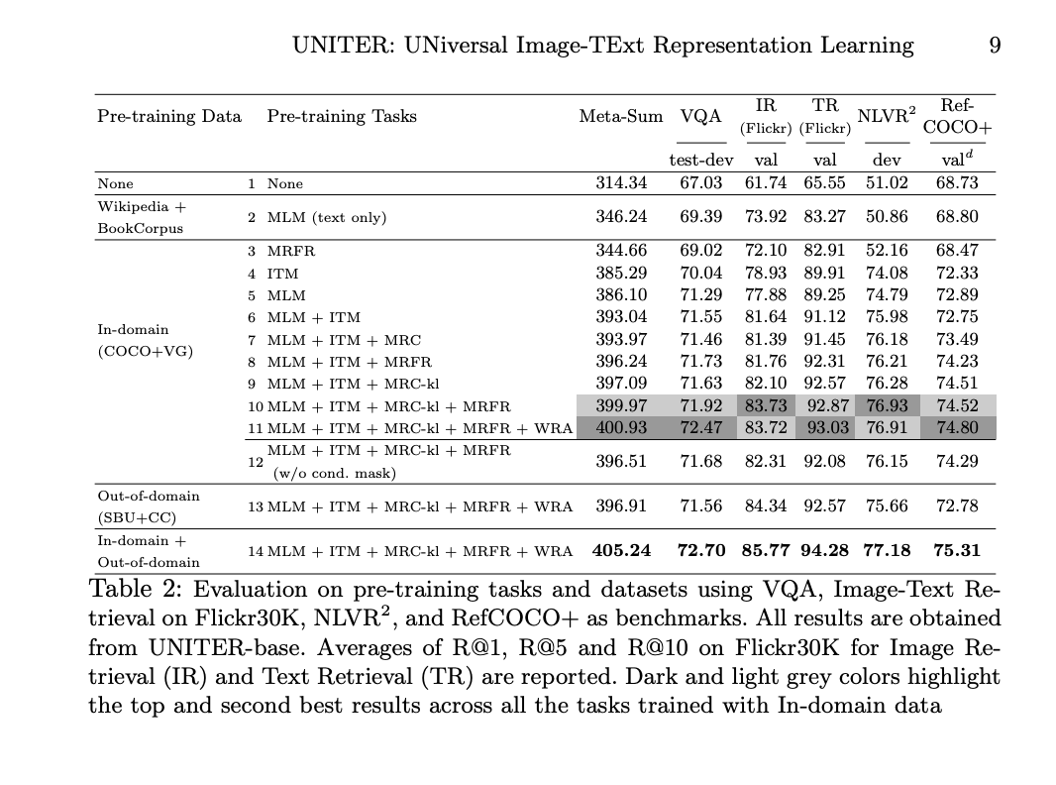
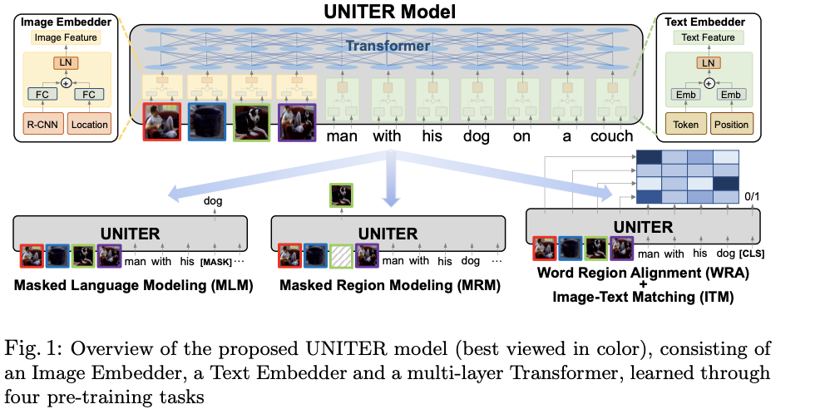
UNiTER
Pre-trained encoder train on vision + language tasks
UNiTER loss function prioritizes
Image + caption alignment
Word region alignment
Intra region understanding
UNiTER model pre-trained on fasterRCNN features
UNiTER: https://arxiv.org/abs/1909.11740

Slide 19
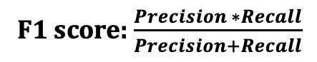
Results (Retrieval)
Algorithm | WebQA Dataset F1 Score
Baseline (12 Self-Attention Heads) | 0.73
Baseline (6-Self Attention Heads) | 0.72
Our Approach (Self-Attention + Cross-Attention) | 0.42
Our Approach (Detectron +Bert) | 0.71
Our Approach (RCNN +Uniter) | 0.21
F1 score: $\frac{Precision ∗Recall}{Precision+Recall}$

Slide 20
Our Approach (Q&A)
[Source-1,Source-2, Source-3, ….]
Q
Key
Value
Query
Key Features:
Epoch time: 2.5 hrs (x 16) (with DDP and p3dn.24xlarge)
Bert-Based encoder
Detectron Features
Cross-Attention Block
Self-Attention Block
Prediction over next 50 words

Slide 21
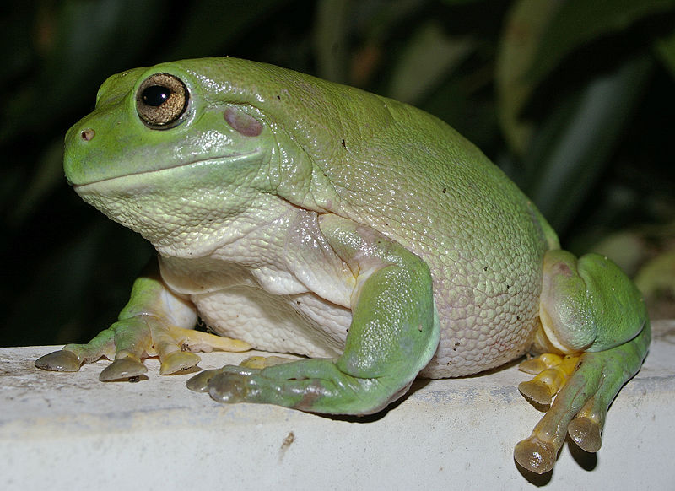
Conclusions
Object detectors may not be able to differentiate Possible Solutions
Need contrastive loss terms during training
Auto-encoder based feature extraction during training
Need to ensure information flow between sources as well as the sources and the answer
Possible Solutions
Strategic Masking of some input sources
Incorporating keyword answers in the loss
Positive image
Negative image

Slide 22
Key Takebacks
For Alexa AI
WebQA language model is too large for a deployment application
Currently 32$ per hour instance might be unfeasible
Need to develop smaller models (FP16 or knowledge distillation or KG)
Application oriented language model might be more fruitful (e.g sports)
For my internship and future research
Evaluation of Generative models (BARTs score is very interesting)
How to train learning models with memory constraints (model parallel)
Working with Datasets and models at scale

Slide 23
Special Thanks
Feiyan Niu
Govind Thattai
Feng Gao
Yadunanda Rao

Slide 24
Memory Issues
model + data memory footprint
Model + data would not fit on on GPU
OOM errors which needed to be fixed
Larger GPUs were unavailable
Attempted techniques
FP16 training
Deepspeed integration
Model Splitting
GPU memory

Slide 25
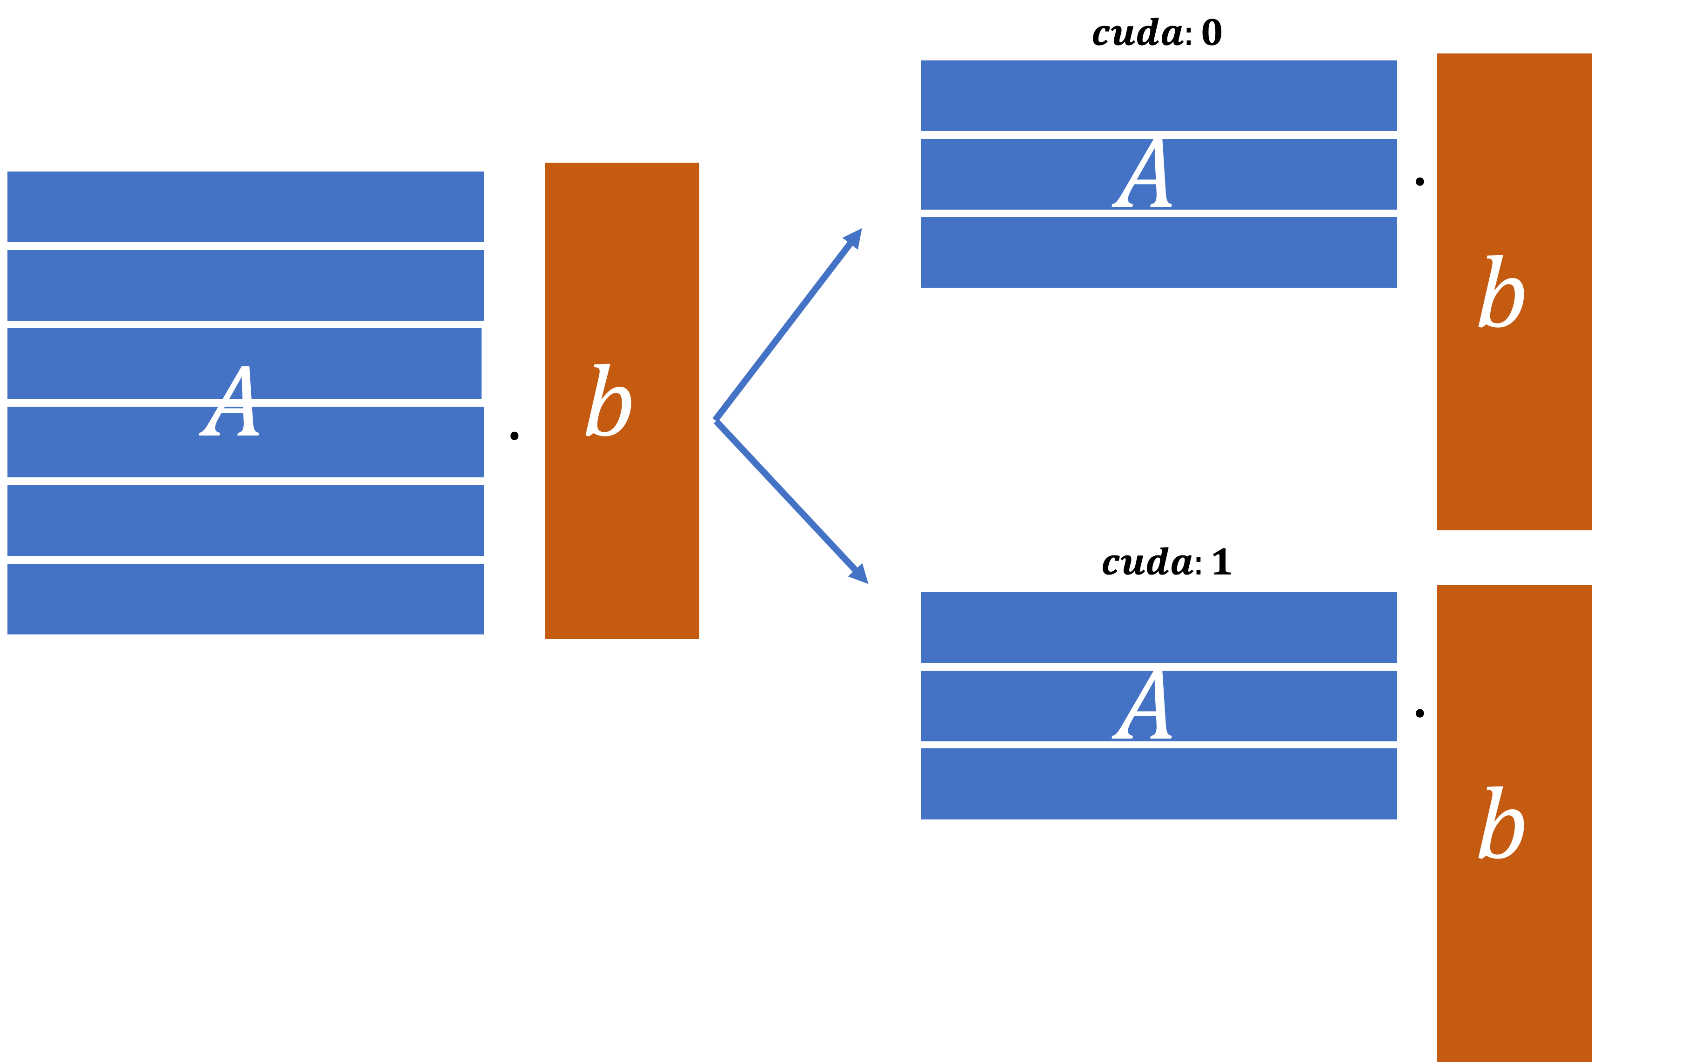
Horizontal Model Splitting
Harder to implement on your own
Libraries available (Deepspeed-ZeRO optimization – FP16)
Less computationally intensive

Slide 26
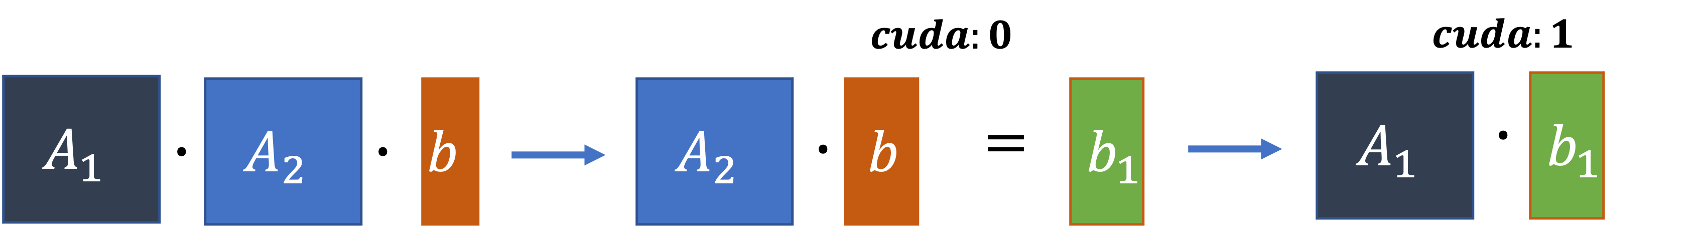
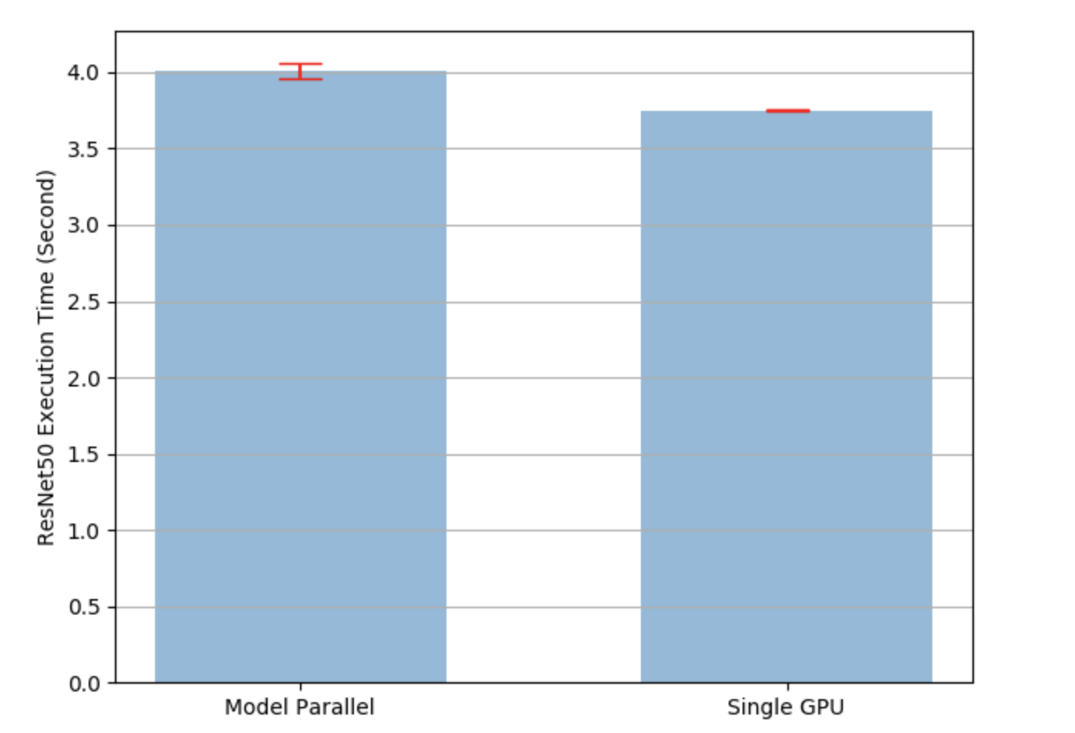
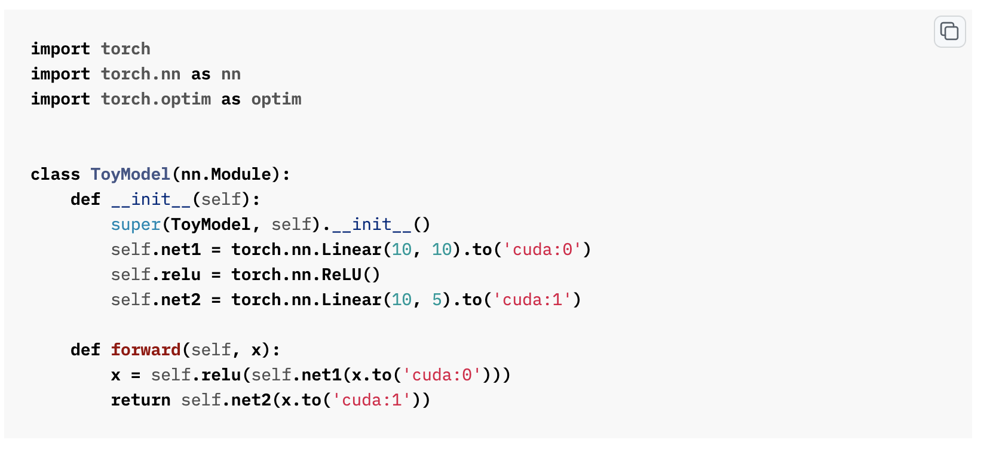
Vertical Model Splitting
Easier to implement
Comes at a computational Cost
22 hrs right upto 26 hrs per epoch
Distributed Data Parallel cannot be used

